Slide 1
IST 3420: Introduction to Data Science and Management
5. Data Summarization and Visualization

Slide 2
Reading
Appendix: Data Summarization and Visualization
http://onlinelibrary.wiley.com/doi/10.1002/9781118874059.app1/pdf
Comprehensive Guide to Data Visualization in R
https://www.analyticsvidhya.com/blog/2015/07/guide-data-visualization-r/
Chart Suggestions—A Thought-Starter
http://extremepresentation.typepad.com/files/choosing-a-good-chart-09.pdf

Slide 3
Learning Objectives
Be able to choose appropriate tabular and basic graphic methods for different types of data (qualitative vs. quantitative)
Understand tabular and basic graphic methods and be able to interpret these visualization results
Understand Simpson’s paradox and be cautious when analyzing data combining all groups
Be able to use ggplot2 to visualize data
Understand spatial data structure
Be able to construct advanced visualization such as spatial plots, hexagon binning, mosaic plot, heat map

Slide 4
Agenda
Introduction to Data Summarization and Visualization
Tabular and Basic Graphical Methods
Statistics and Graphs May Lie
Graphical Parameters
Visualizing Data Using ggplot2 Package
Visualizing Spatial Data
Some Advanced Visualization Methods

Slide 5
Recap: Hierarchy of Measurement Scales
A higher level scale contains all properties of its lower scale.
From lower to higher levels, analysis tends to be more comprehensive. Improper use of lower level scales suffers information loss in the data
In general, we prefer a higher scale of measurement than a lower one.
Ratio
Has absolute zero
Quantitative
Interval
Distance makes sense
Ordinal
Attributes can be ranked
Qualitative
Nominal
Values are names or labels

Slide 6
Summarize and Visualize Data
Summarizing and visualizing data facilitates communication of data analysis to the users or customers.
Data types
Qualitative data (nominal, interval)
Quantitative data (ordinal, ratio)
Approaches
Tabular methods
Graphical methods

Slide 7
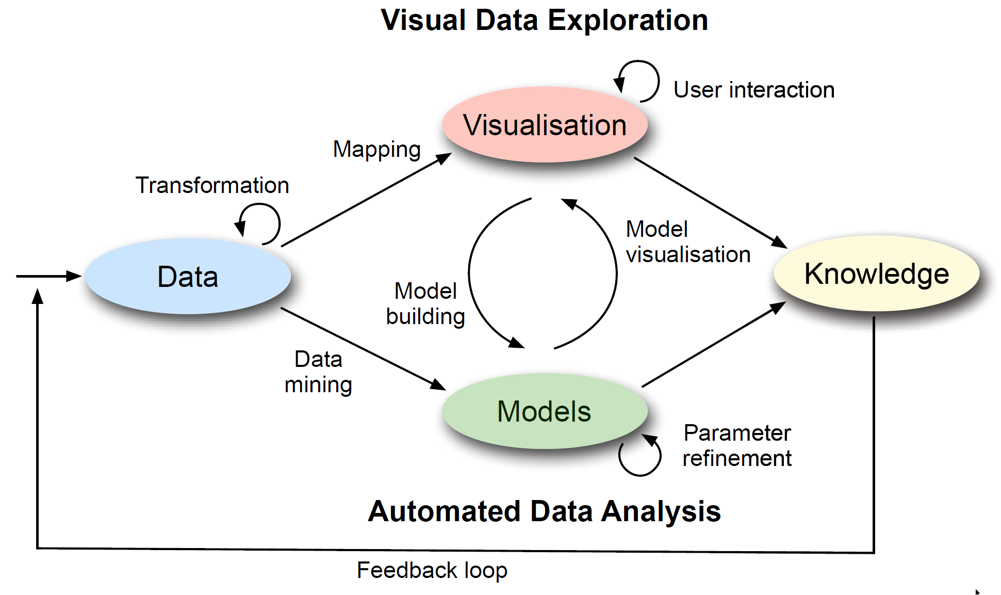
Data Visualization
“A picture is worth a thousand words”
“The purpose of visualization is insight, not pictures”

Slide 8
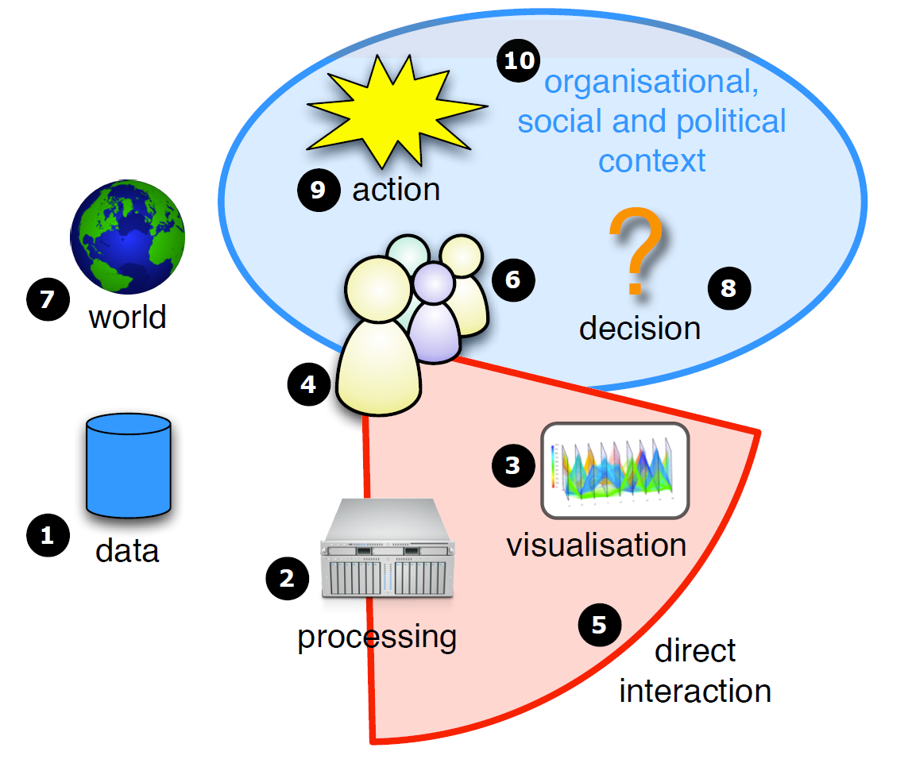
Visualization Amplifies Human Cognition
Information visualization amplifies human cognitive capability in six basic ways:
by increasing cognitive resources, such as by using a visual resource to expand human working memory,
by reducing search, such as by representing a large amount of data in a small space,
by enhancing the recognition of patterns, such as when information is organized in space by its time relationships,
by supporting the easy perceptual inference of relationships that are otherwise more difficult to induce,
by perceptual monitoring of a large number of potential events, and
by providing a manipulable medium that, unlike static diagrams, enables the exploration of a space of parameter values

Slide 9
Why Visualization is Important? Anscombe's Quartet
In 1973 Francis Anscombe demonstrated four datasets:
I |  | II |  | III |  | IV
x | y | x | y | x | y | x | y
10.0 | 8.04 | 10.0 | 9.14 | 10.0 | 7.46 | 8.0 | 6.58
8.0 | 6.95 | 8.0 | 8.14 | 8.0 | 6.77 | 8.0 | 5.76
13.0 | 7.58 | 13.0 | 8.74 | 13.0 | 12.74 | 8.0 | 7.71
9.0 | 8.81 | 9.0 | 8.77 | 9.0 | 7.11 | 8.0 | 8.84
11.0 | 8.33 | 11.0 | 9.26 | 11.0 | 7.81 | 8.0 | 8.47
14.0 | 9.96 | 14.0 | 8.10 | 14.0 | 8.84 | 8.0 | 7.04
6.0 | 7.24 | 6.0 | 6.13 | 6.0 | 6.08 | 8.0 | 5.25
4.0 | 4.26 | 4.0 | 3.10 | 4.0 | 5.39 | 19.0 | 12.50
12.0 | 10.84 | 12.0 | 9.13 | 12.0 | 8.15 | 8.0 | 5.56
7.0 | 4.82 | 7.0 | 7.26 | 7.0 | 6.42 | 8.0 | 7.91
5.0 | 5.68 | 5.0 | 4.74 | 5.0 | 5.73 | 8.0 | 6.89
Property | Value
Mean of x | 9
Sample variance of x | 11
Mean of y | 7.50
Sample variance of y | 4.125
Correlation between x and y | 0.816
Linear regression line | y = 3.00 + 0.500x
Source: https://en.wikipedia.org/wiki/Anscombe's_quartet

Slide 10
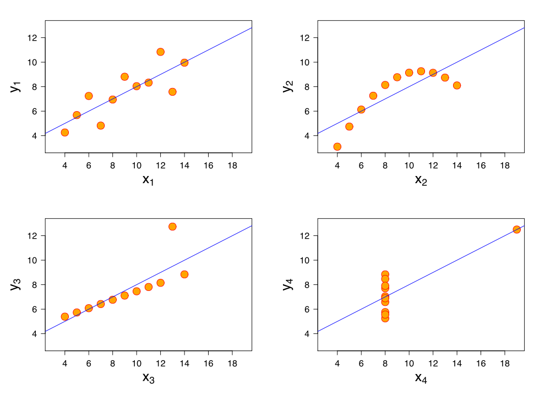
Why Visualization is Important? Anscombe’s Quartet
The dangers of summary statistics:
All four datasets are identical when examined using simple summary statistics, but vary considerably when graphed.
Always plot your data
Source: https://en.wikipedia.org/wiki/Anscombe's_quartet
Notes:
That means: summary statistics even regression analysis cannot tell the full story.

Slide 11
Summarize and Visualize Data
Using Tabular and Basic Graphical Methods

Slide 12
Overview of Basic Visualization Methods
Category | Method | Qualitative Data | Quantitative Data
Tabular Methods | Frequency Distribution | Yes | Yes
 | Relative Frequency Distribution | Yes | Yes
 | Percent Frequency Distribution | Yes | Yes
 | Cumulative Frequency Distribution |  | Yes
 | Cumulative Rel. Freq. Distribution |  | Yes
 | Cross tabulation | Yes | Yes
Basic Graphical Methods | Bar Plot | Yes
 | Pie Chart | Yes
 | Dot Plot |  | Yes
 | Box Plot |  | Yes
 | Density Plot |  | Yes
 | Line Chart |  | Yes
 | Scatter Plot |  | Yes

Slide 13
Tabulate A Single Variable
Both qualitative and quantitative data
Frequency distribution: shows the frequency (or count) of items
Relative frequency distribution: shows frequency proportion of items
Quantitative data
Accumulative frequency distribution: shows frequency below a level
Accumulative relative frequency distribution: shows frequency proportion below a level

Slide 14
R Code: Tabulate Qualitative Data
## Part 1. Tabulate Qualitative Data ##
# Calculate frequency
gear.freq <- table(mtcars$gear)
gear.freq
cbind(gear.freq) # Print frequency in column format
# Calculate relative frequency
gear.rel.freq <- gear.freq/nrow(mtcars)
gear.rel.freq
cbind(gear.rel.freq) # Print relative frequency
cbind(gear.freq, gear.rel.freq) # Print frequency and relative frequency
> cbind(gear.freq, gear.rel.freq
gear.freq gear.rel.freq
3 15 0.46875
4 12 0.37500
5 5 0.15625
Interpretation: Most cars have 3 or 4 gears.

Slide 15
Tabulate Quantitative Data
Quantitative data are measured in ordinal and/or ratio scales.
Directly counting the number of unique values is meaningless.
Procedure of Tabulating Quantitative Data
Calculate Range
Determine Break Points
Classify Observations into Sub-Intervals
Calculate Frequency in Each Sub-Interval

Slide 16
R Code: Tabulate Quantitative Data
mpg <- mtcars$mpg
# Calculate range
range(mpg)
# Determine break points
breaks <- seq(10,35, by = 5)
# Classify observations into sub-intervals
mpg.cut <- cut(mpg, breaks, right = FALSE)
# Calculate frequency in each sub-interval
mpg.freq <- table(mpg.cut)
cbind(mpg.freq) # Print in column format
# Calculate cumulative frequency
mpg.cum.freq = cumsum(mpg.freq)
cbind(mpg.cum.freq)
# Calculate relative frequency
mpg.rel.freq <- mpg.freq/nrow(mtcars)
cbind(mpg.rel.freq)
# Calculate cumulative relative frequency
mpg.cum.rel = cumsum(mpg.rel.freq)
cbind(mpg.cum.rel)
# Print all in column format
cbind(mpg.freq, mpg.cum.freq, mpg.rel.freq, mpg.cum.rel)

Slide 17
Tabulate 2 or More Categorical Variables
A contingency table is a special type of frequency distribution table, where two or more variables are shown simultaneously.
xtabs() returns similar results as table(), takes arguments differently, e.g xtabs( region+income)
# Create a two-way frequency table
cyl_gear <- table(mtcars$cyl,mtcars$gear)
cyl_gear
# Calculate table margin
margin.table(cyl_gear,1)
margin.table(cyl_gear,2)
# Create a three-way frequency table
cyl_gear_carb <- table(mtcars$cyl,mtcars$gear, mtcars$carb)
cyl_gear_carb
ftable(cyl_gear_carb) # Print as flat contingency table
# Use xtabs() to create contingency tables
xtabs(~ cyl + gear, data = mtcars)
ftable(xtabs(~ cyl + gear + carb, data = mtcars))
> xtabs(~ cyl + gear, data = mtcars)
gear
cyl 3 4 5
4 1 8 2
6 2 4 1
8 12 0 2
> ftable(xtabs(~ cyl + gear + carb,
data = mtcars))
carb 1 2 3 4 6 8
cyl gear
4 3 1 0 0 0 0 0
4 4 4 0 0 0 0
5 0 2 0 0 0 0
6 3 2 0 0 0 0 0
4 0 0 0 4 0 0
5 0 0 0 0 1 0
8 3 0 4 3 5 0 0
4 0 0 0 0 0 0
5 0 0 0 1 0 1

Slide 18
Cross Tabulate Quantitative Variables
Like creating frequency table, cross-tabulating quantitative variables involves using a sequence of sub-intervals.
# Cross tabulate mpg and cylinder
car1 <- mtcars
range(car1$mpg)
break1 <- seq(10,35, by = 5)
break1
car1$mpg.cut <- cut(car1$mpg, breaks, right = FALSE)
xtabs(~ mpg.cut + cyl, data = car1)
Interpretation: Cars with more cylinders tend to have lower miles per gallon.

Slide 19
Visualize Data in R
R provides strong data visualization capabilities
Basic graphs for qualitative variables
bar plots (simple, stacked, grouped)
pie charts (simple, annotated)
Basic graphs for quantitative variables
dot plots
boxplots
density plots (histograms and kernel density plots)
line charts
scatter plots
Advanced graphs

Slide 20
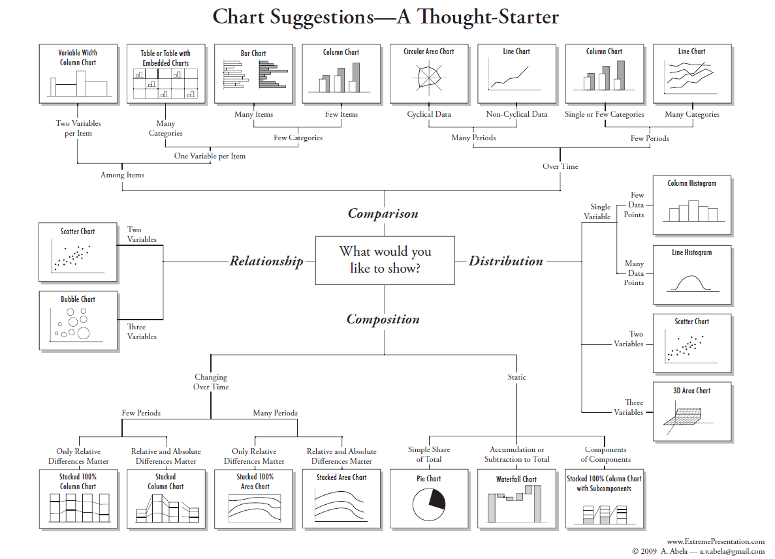

Slide 21
Bar Plots (Qualitative Data)
Syntax: barplot(height, ...)
Three types
Simple bar plots
Stacked bar plots
Grouped bar plots

Slide 22
R Code: Simple Bar Plots
## Simple Bar Plots ##
car.cyl <- table(mtcars$cyl)
car.cyl
str(car.cyl)
# A simple bar plot
barplot(car.cyl)
# A simple bar plot with more details
barplot(car.cyl,
main = "Distribution of Car Cylinders",
xlab = "Number of Cylinders",
names.arg = c("4 Cylinders", "6 Cylinders", "8 Cylinders"),
col = rainbow(3))

Slide 23
R Code: Stacked and Grouped Bar Plots
## Stacked Bar Plots ##
cyl.gear <- table(mtcars$cyl,mtcars$gear)
cyl.gear
str(cyl.gear)
barplot(cyl.gear,
main="Distribution of Cylinders by Gear",
xlab="Number of Gears",
col=rainbow(3),
legend = rownames(cyl.gear))
## Grouped Bar Plots ##
barplot(cyl.gear,
main="Distribution of Cylinders by Gear",
xlab="Number of Gears",
col=rainbow(3),
legend = rownames(cyl.gear),
beside=TRUE)

Slide 24
Pie Plots (Qualitative Data)
Syntax: pie(x, labels = names(x),...)

Slide 25
R Code: Pie Chart
## Pie Plot ##
car.cyl <- table(mtcars$cyl)
lb1 <- paste(names(car.cyl), " cylinders\n", car.cyl, sep="")
pie(car.cyl,
labels = lb1,
main="Pie Chart of Cylinders\n (with count of cars)",
col=rainbow(length(lb1))
)
# Calculate percentage
pct <- round(car.cyl/sum(car.cyl)*100, digits = 1)
lb2 <- paste(names(car.cyl), " cylinders\n", paste(pct,"%"), sep="")
pie(car.cyl,
labels = lb2,
main="Pie Chart of Cylinders",
col=rainbow(length(lb2))
)

Slide 26
Dot Plots (Quantitative Data)
Syntax: dotchart(x, labels = ,...)
cex: the character size to use (a very useful setting to avoid label overlap).
groups: an optional factor indicating how the elements of x are grouped.
color: the color(s) to be used for points and labels.
gcolor: the single color to be used for group labels and values.

Slide 27
R Code: Dot Plots
A simple dot plot
# A simple dot plot
dotchart(mtcars$mpg,
labels = row.names(mtcars),
cex = 0.6,
main="Gas Milage",
xlab = "MPG")

Slide 28
R Code: Dot Plots
A dot plot with grouped elements
# A dot plot with grouped elements
x <- mtcars[c("mpg","cyl")]
x <- x[order(x$mpg),]
x$color <- x$cyl
x$color <- dplyr::recode(x$color,`4` = "red", `6` = "green", `8` = "blue")
x$cyl <- as.factor(x$cyl) # In order to show factor label in dotchart
str(x)
dotchart(x$mpg,
labels = row.names(x),
cex = 0.6,
main="Gas Milage\nGrouped by Cylinder",
xlab = "MPG",
groups = x$cyl,
color = x$color)

Slide 29
A Five-Number Summary (Quantitative Data)
Use the following 5 numbers to summarize data
1. Smallest value
2. First quartile (Q1)
3. Median (Q2)
4. Third quartile (Q3)
5. Largest value
Procedure:
Step 1: Sort the data in ascending order;
Step 2: Calculate the smallest value, the three quartiles, and the largest value.
23 12 24 55 60 34 20 17 19 37 43 51
12 17 19 20 23 24 34 37 43 51 55 60
Q1=19.75
Q2=29
Q3=45
(Sample Quantile Type 7)

Slide 30
Boxplots (a.k.a. Box-and-Whisker Plots)
Box-and-whisker plots summarize data based on a five- number summary.
First/lower quartile (Q1)
Middle quartile/median (Q2)
Third/upper quartile (Q3)
Interquartile range IQR = Q3 - Q1
Upper limit = Q3 + 1.5IQR
Lower limit = Q1 – 1.5IQR
Outliers: beyond the range [Q1 – 1.5IQR, Q3 + 1.5IQR]
outliers
upper limit or max value (smaller one)
whiskers
IQR
median
lower limit or min value (larger one)

Slide 31
R Code: Box Plot
Simple box plot
# Box plot of a variable
set.seed(1)
x1 <- rnorm(100, mean = 5, sd = 2)
x1[88] <- 12; x1[89] <- 11.8 # Set two outliers
quantile(x1)
boxplot(x1)
boxplot(x1,notch=TRUE) # Draw a notch in each side of the box

Slide 32
R Code: Box Plot
Box plot by group
# Box plot of a variable by group
boxplot(mpg ~ cyl, data = mtcars, main = "Mileage by Cylinder")
boxplot(mpg ~ cyl*am, data = mtcars, main = "Mileage by Cylinder and Transmission", col = rainbow(3))

Slide 33
Density Plots (Quantitative Data)
Histogram
A histogram visualize the distribution of a variable in terms of frequency, relative frequency, or percent frequency.
A histogram can be thought of as a simplified kernel density plot.
Kernel Density Plot
A kernel density plot uses a kernel algorithm to smooth frequencies over the bins.
This yields a smoother probability density function, which will in general more accurately reflect distribution of the underlying variable.
Source: https://en.wikipedia.org/wiki/Histogram

Slide 34
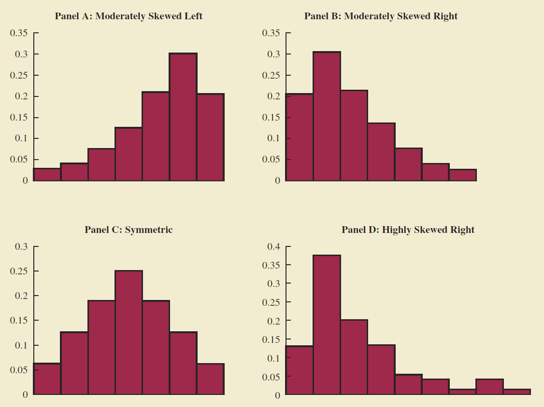
Histograms
A histogram reveals the shape of distribution.
Image source: Anderson et al. “Statistics for business & economics” (11e)

Slide 35
Histograms vs. Bar Charts
Histograms are used to visualize the distribution of quantitative data.
Bar charts are used to summarize qualitative data.
No gaps
Gaps
Adjacent bins (usually equal size)
Categories

Slide 36
R Code: Histograms
# Only show 2*1 plots on a page
par(mfrow=c(2,1))
hist(mtcars$mpg)
hist(mtcars$mpg,
main = "Distribution of MPG",
xlab = "MPG",
probability = TRUE)
# Add a normal curve
curve(dnorm(x, mean=mean(mtcars$mpg),
sd=sd(mtcars$mpg)),
col="blue",
add=TRUE)
Interpretation: The distribution of mpg is moderately right skewed.

Slide 37
Determine the Number of Bins
We can set the breaks parameter to other numbers.
Different bin sizes can reveal different features of the data:
Less bins lead to oversmoothing and bias
More bins result in imprecise estimation due to extra noise
There is no "best" number of bins.
By default, R hist() function use Sturges’ Rule to determine the number of breaks: k = ceiling(log₂n+1)

Slide 38
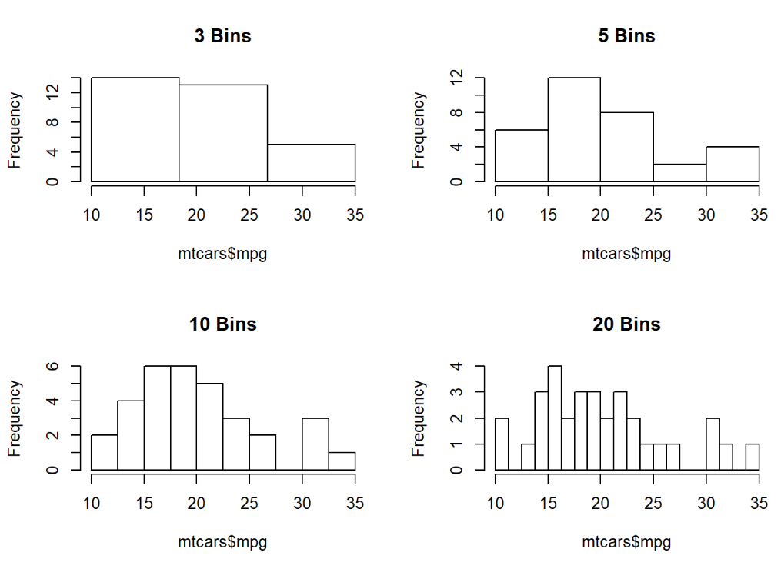
R Code: Set the Number of Bins
# Range of mpg: 10.4~33.9
range(mtcars$mpg)
# Only show 2*2 plots on a page
par(mfrow=c(2,2))
hist(mtcars$mpg, main = "3 Bins",
breaks = seq(10,35, l= 4))
hist(mtcars$mpg, main = "5 Bins",
breaks = seq(10,35, l= 6))
hist(mtcars$mpg, main = "10 Bins",
breaks = seq(10,35, l= 11))
hist(mtcars$mpg, main = "20 Bins",
breaks = seq(10,35, l= 21))

Slide 39
Kernel Density Plots
Density, or probability density function (PDF), is a function that describes the relative probability for a variable to hold a given value.
Density is usually a better way to describe the distribution of a quantitative variable.
Use R function density() to calculate univariate kernel density estimation

Slide 40
R Code: Kernel Density Plots
# Kernel density plot
dst <- density(mtcars$mpg) # Calculate kernel density estimate
plot(dst, type = "n", main = "Kernel Density Estimate of MPG")
polygon(dst, col = "wheat") # Fill kernel density plot

Slide 41
Line Charts (Generic Plots)
Syntax: plot(x, y, ...)
Parameter type
"p" for points,
"l" for lines,
"b" for both,
"c" for the lines part alone of "b"
"o" for both ‘overplotted’
"h" for ‘histogram’ like (or ‘high-density’) vertical lines,
"s" for stair steps,
"S" for other steps
"n" for no plotting

Slide 42
Two Ways to Plot Line Charts
Use plot(x, y,...) to directly plot x, y data in a graph
Use plot(x,y,type=“n”,...) to create a plot without points and lines, then use lines(x,y,...) to add points and lines
This method allows plotting multiple lines

Slide 43
R Code
## Line charts ##
x <- c(0:10); y <- x^2; z <- 100-y # create data to plot
par(mfrow=c(1,1)) # Only show one plot on a page
plot(x,y) # Create a plot with default parameters
plot(x,y,type = "o") # Create a plot with overplotted points and lines
# Use plot() to create a plot without points and lines, then use lines(x,y, ...) to add points and lines
plot(x,y,type = "n", main = "A Line Chart", ylab = "y or z")
lines(x,y,type = "o", col = "green")
lines(x,z,type = "o", col = "blue")
legend(6,95,legend = c("y","z"),lty=c(1,1),col=c("green","blue"))

Slide 44
Scatter Plots
A scatter plot presents the relationship between two quantitative variables.
A trend line can be used to approximate the relationship.
A scatterplot matrix is preferred when we want to roughly determine the relationship among multiple variables.

Slide 45
Interpreting Scatter Plots
A positive relationship

Slide 46
Interpreting Scatter Plots
A negative relationship

Slide 47
Interpreting Scatter Plots
A curvilinear relationship

Slide 48
Interpreting Scatter Plots
No relationship

Slide 49
R Code: Scatter Plots
plot(mtcars$mpg, mtcars$wt, xlab="MPG", ylab="Weight")
abline(lm(mtcars$wt~mtcars$mpg), col="red") # Add regression fit line (y~x)
lines(lowess(mtcars$mpg,mtcars$wt), col="blue") # Add lowess fit line (x,y)
Interpretation: Cars with higher weight tend to have less miles per gallon.
LOWESS = Locally Weighted Scatterplot Smoothing

Slide 50
R Code: Scatter Plot Matrix
A better way to roughly show the relationship between multiple variables
Scatterplot matrices are good for determining rough linear correlations of metadata that contain continuous variables.
Scatterplot matrices are not so good for looking at discrete variables.
pairs(~mpg+disp+hp+wt, data=mtcars, main="A Scatterplot Matrix")

Slide 51
Statistics and Graphs May Lie

Slide 52
Simpson’s Paradox
A statistical trend that appears in several different groups may disappear or even reverse when all groups are combined.
y
Group B
y
Group B
Group A
Group A
x
x
When two groups are considered individually
When two groups are considered together

Slide 53
Simpson’s Paradox: An Example
Graduate school admissions to UC Berkeley for Fall 1973
 | Applicants | Admitted
Men | 8442 | 44%
Women | 4321 | 35%
It seems men were more likely than women to be admitted.

Slide 54
Simpson’s Paradox: An Example (cont.)
Check the detailed admission data at six largest departments
Department | Men |  | Women
 | Applicants | Admitted | Applicants | Admitted
A | 825 | 60% | 108 | 82%
B | 560 | 63% | 25 | 68%
C | 325 | 37% | 593 | 34%
D | 417 | 33% | 375 | 35%
E | 191 | 28% | 393 | 24%
F | 272 | 6% | 341 | 7%
Admissions were actually slightly biased in favor of women.
Women tended to apply to competitive departments with low rates of admission even among qualified applicants (such as in the English Department), whereas men tended to apply to less-competitive departments with high rates of admission among the qualified applicants (such as in engineering and chemistry).

Slide 55
Correlation vs. Causation
A common mistake is to confuse correlation with causation
Correlation measures the degree that two variables move with each other;
Causation means one variable has effect on another.
y
X causes Y
Y causes X
A 3rd factor Z causes both X and Y
……
x

Slide 56
Graphical Parameters

Slide 57
Graphical Parameters
R uses graphical parameters to control the display of graphs.
Font
Color
Line
Symbol
Title
...
Type “?par” to learn more.
In this section, we’ll learn some commonly used parameters.

Slide 58
Color Parameters
col = : Default plotting color
col.axis = : Color for axis annotation
col.lab = : Color for x and y labels
col.main = : Color for main titles
col.sub = : Color for sub-titles
bg = : Plot background color
fg = : Plot foreground color

Slide 59
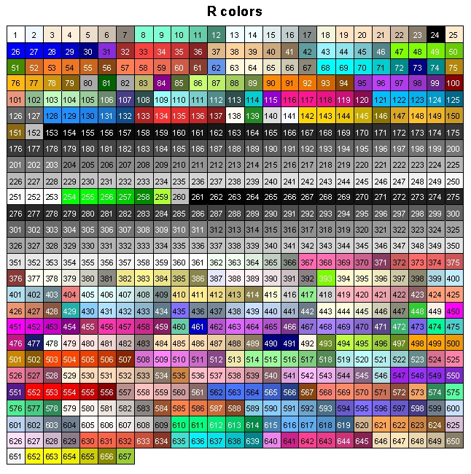
Color Values
Color value(s) can be specified as index, name, hexadecimal, or RGB.
Source: http://research.stowers-institute.org/efg/R/Color/Chart/index.htm

Slide 60
(cont.)
Use colors() to show all color names
Use the following commands to create a vector of n contiguous colors:
rainbow(n)
heat.colors(n)
terrain.colors(n)
topo.colors(n)
cm.colors(n)

Slide 61
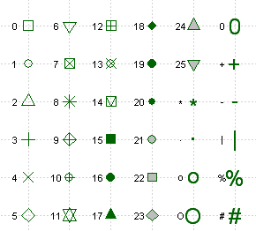
pch = : Plot Character
Either a single character or an integer code for one of a set of graphics symbols to be used as plotting symbols.
Image source: http://www.statmethods.net/advgraphs/parameters.html

Slide 62
Size Magnification for Text and Symbols
cex = : A numerical value giving the amount by which plotting text and symbols should be magnified relative to the default.
cex.axis = : Magnification of axis annotation relative to cex
cex.lab = : Magnification of x and y labels relative to cex
cex.main = : Magnification of main titles relative to cex
cex.sub = : Magnification of sub titles relative to cex

Slide 63
Font Parameters
font = : Integer specifying font to use (1=plain, 2=bold, 3=italic, 4=bold italic, 5=symbol)
font.axis = : Font for axis annotation
font.lab = : Font for x and y labels
font.main = : Font for main titles
font.sub = : Font for sub-titles
ps = : Font point size (text size = ps*cex)
family = : Font family for drawing text

Slide 64
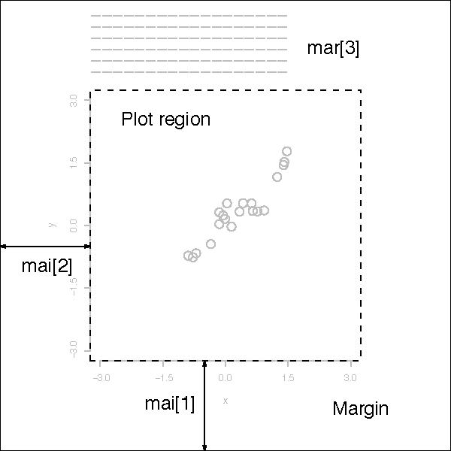
Margins: mar or mai
mai = : A numerical vector of the form c(bottom, left, top, right) which gives the margin size specified in inches.
mar = : A numerical vector of the form c(bottom, left, top, right) which gives the number of lines of margin to be specified on the four sides of the plot. The default is c(5, 4, 4, 2) + 0.1.

Slide 65
Visualize Data Using ggplot2 Package

Slide 66
ggplot2 Package
Based on the Grammar of Graphics, a general scheme for data visualization
A graph can be built from several components:
A dataset
A set of geoms(geometric objects)
A coordinate system
...
Two common types of usage
Use quick plotting qplot() function to create basic graphs
Use ggplot() and other functions to create ggplot2 graphs
For more detail, refer to http://docs.ggplot2.org/current/

Slide 67
Quick Plotting
qplot() is the basic quick plotting function in the ggplot2 package.
It is very similar to the base R plot() function.
It's a convenient wrapper for creating a number of different types of plots using a consistent calling scheme.

Slide 68
qplot() Syntax
qplot(x, y = NULL, ..., data, facets = NULL, margins = FALSE, geom = "auto",
xlim = c(NA, NA), ylim = c(NA, NA), log = "", main = NULL,
xlab = deparse(substitute(x)), ylab = deparse(substitute(y)), asp = NA)
x, y, ... | Aesthetics passed into each layer
data | Data frame to use
facets | faceting formula to use.
margins | display marginal facets?
geom | Character vector specifying geom(s) to draw. Defaults to "point" if x and y are specified, and "histogram" if only x is specified. Other values include "smooth", "boxplot", "line", "density", "bar", and "jitter".
xlim, ylim | X and y axis limits
log | Which variables to log transform ("x", "y", or "xy")
main, xlab, ylab | Character vector (or expression) giving plot title, x axis label, and y axis label respectively.
asp | The y/x aspect ratio

Slide 69
R Code: ggplot2::qplot()
library(ggplot2)
# Use default geoms
qplot(mpg, data = mtcars)
qplot(mpg, wt, data = mtcars)
qplot(mpg, wt, data = mtcars, colour = cyl)
qplot(mpg, wt, data = mtcars, size = cyl)
qplot(mpg, wt, data = mtcars, facets = vs ~ am)
# Use different geoms
qplot(mpg, data = mtcars, geom = "density")
qplot(mpg, data = mtcars, geom = "dotplot")
qplot(cyl, mpg, data = mtcars, geom = "boxplot")
qplot(cyl, data = mtcars, geom = "bar")
qplot(mpg, wt, data = mtcars, geom = c("path","point"))
qplot(mpg, wt, data = mtcars, geom = "smooth")
qplot(mpg, wt, data = mtcars, geom=c("point", "smooth"))
qplot(mpg, wt, data = mtcars, geom=c("point", "smooth"), color = cyl)
qplot(mpg, wt, data = mtcars, geom=c("point", "smooth"), shape = cyl)
qplot(cyl, wt, data = mtcars, geom = c("boxplot", "point"))
qplot(factor(cyl), wt, data = mtcars, geom = c("boxplot", "jitter"))
qplot(factor(cyl), wt, data = mtcars, geom = c("boxplot", "jitter"), fill = cyl)

Slide 70
Customize ggplot2 Graphs
We know that the display of base R graphs can be customized by using par().
For ggplot2 graphs, we use a set of theme functions.
We can use "+" to chain ggplot2 functions to draw the final graph.

Slide 71
R Code: Customize ggplot2 Graphs
## Use theme to customize display ##
p <- qplot(factor(cyl), wt, data = mtcars, geom = c("boxplot", "jitter"), fill = cyl)
# Use print(p) or simply use "p" to show the graph p
print(p)
p
# Use "+" to chain ggplot2 functions to draw the final graph
p + theme_bw()
p + theme_bw() + theme(axis.title=element_text(face="bold.italic", size="14", color="blue"),
legend.position="bottom")

Slide 72
Use ggplot() and Other Functions
Syntax: ggplot(data = NULL, mapping = aes(), ..., environment = parent.frame())
Aesthetic mappings describe how variables in the data are mapped to visual properties (aesthetics) of geoms.
We typically construct a plot incrementally, using the “+” operator to add layers to the existing ggplot object.

Slide 73
R Code: Use ggplot() Function
# Construct basic plot
p1 <- ggplot(data = mtcars, aes(x = wt, y = mpg))
p2 <- ggplot(data = mtcars, aes(x = cyl, y = mpg))
# Plot points with default display style
p1 + geom_point()
p2 + geom_boxplot()
# Use different display
p1 + geom_point(size = 4)
p1 + geom_point(col = "blue")
p1 + geom_point(aes(col = cyl))
p1 + geom_point(col = "blue") + geom_line()
# Add smoothing line (by default using loess smoothing method)
p1 + geom_point(col = "blue") + geom_smooth()
# Add smoothing line using linear regression method
p1 + geom_point(col = "red") + geom_smooth(method = "lm")
p1 + geom_point(col = "red") + geom_smooth(method = "lm", se = FALSE)
p1 + geom_point(col = "red") + geom_smooth(method = "lm", se = FALSE) + theme_bw()
p1 + geom_point(aes(col = cyl)) +
geom_smooth(method = "lm", se = FALSE) + theme_bw() +
labs(title = "Relationship between Weight and MPG", x="Weight", y = "Miles per Gallon") +
scale_color_discrete(name = "", labels = c("4 cylinders","6 cylinders", "8 cylinders"))
p1 + geom_point(aes(col = am)) +
geom_smooth(method = "lm", se = FALSE) + theme_bw() +
labs(title = "Relationship between Weight and MPG", x="Weight", y = "Miles per Gallon") +
scale_color_discrete(name = "Tansmission")

Slide 74
Visualize Spatial Data

Slide 75
Spatial Data
Spatial data (a.k.a. geospatial data) represent the location, size, and shape of physical objects (such as cities, lake, mountains, buildings etc.) by numbers in a geographic coordinate system.
Geographic information systems (GIS) can visualize and analyze the spatial data.
R has many packages that provide GIS functions to analyze spatial data. For the detail, refer to https://cran.r-project.org/web/views/Spatial.html

Slide 76
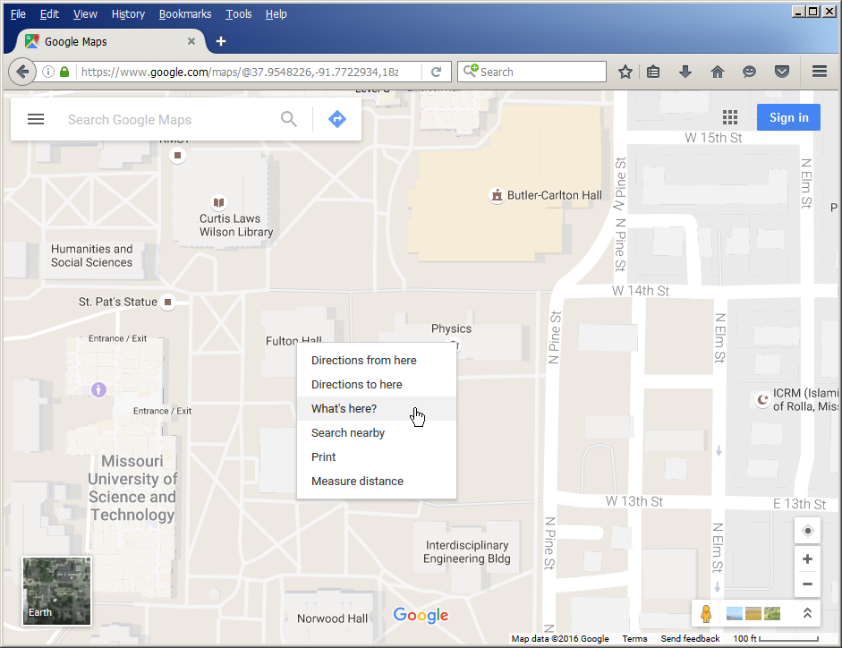

Get the Coordinates of a Place through Google Maps
On Google Maps, right-click the place or area.
Select What's here?
A card appears at the bottom of the screen with more info.

Slide 77
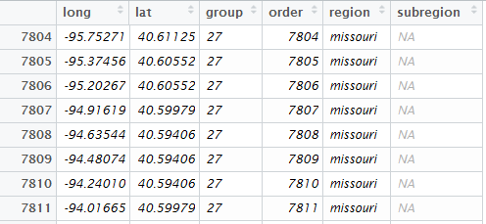
Understand Spatial Data
US state boundaries map data in “maps” package
Use ggplot2::map_data("state") to create a data frame containing map boundary data for all US states
Check the Missouri state map boundary data
Longitude
Latitude
Sequence of coordinate

Slide 78
Use plot() to Draw Missouri State Boundary
# Create a data frame of map data for all states
us_states <- ggplot2::map_data("state")
head(us_states)
# Select Missouri data
mo <- us_states[which(us_states$region=="missouri"),]
mo # long: longitude, lat: latitude
# Plot the shape of Missouri state
plot(mo$long,mo$lat)
# A better plot of the shape
plot(mo$long,mo$lat, type = "l")

Slide 79
(cont.)
Add more details
# Add more details
plot(mo$long,mo$lat, type = "n") # Draw a blank plot
polygon(mo$long,mo$lat, col = "green") # Add polygon
points(-91.774069, 37.954234, col = "red") # Add MST location
text(-91.774069, 37.954234,"MST", pos = 3, cex = 0.6) # Label the location

Slide 80
Draw Boundaries for All States
plot(us_states$long,us_states$lat, type = "n")
col_set = rainbow(63)
for (i in unique(us_states$group)){
state <- us_states[which(us_states$group == i),]
polygon(state$long,state$lat, col = col_set[i])
}

Slide 81
Use maps::map() function to draw
A better way to draw map is to use functions in R packages
maps::map(database = "state",region = "missouri", fill = TRUE, col = "green")
maps::map(database = "state", fill = TRUE, col = heat.colors(49))

Slide 82
(cont.)
maps::map(database = "usa")
maps::map(database = "county")

Slide 83
(cont.)
maps::map(database = "world")

Slide 84
Application Case: Visualize US Population on Maps
Data Source:
The original dataset of US population by state was collected from U.S. Census Bureau (https://www.census.gov/popest/data/state/totals/2015/tables/NST-EST2015-01.csv)
The following CSV file simplifies the data by only including 2010 data. US_Population_2010.csv
Task:
To visualize the population by state on the map of US states

Slide 85
R Code: Visualize US Population on Maps
Refer to US_Population_on_Map.RMarkdown

Slide 86
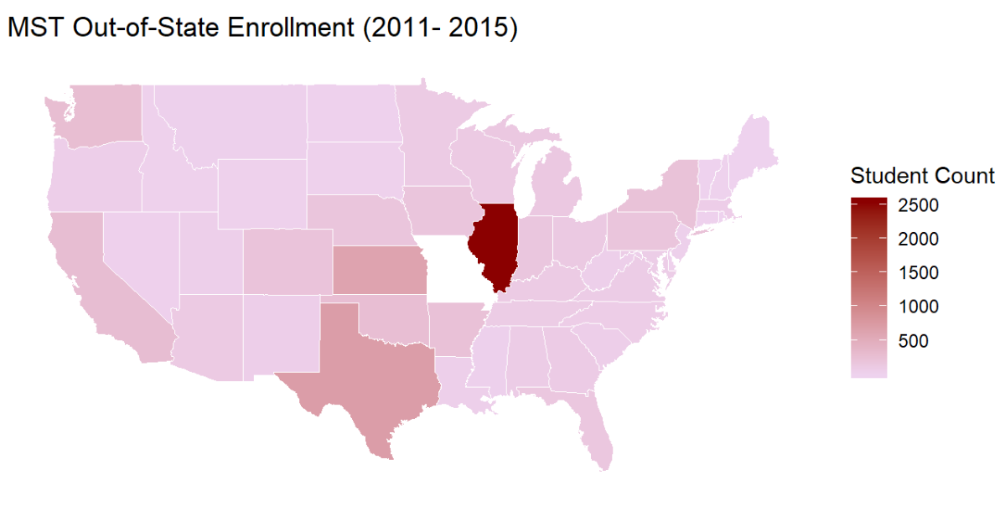
Homework
Plot MST out-of-state enrollment on US map

Slide 87
Some Advanced Visualization Methods

Slide 88
Some Advanced Visualization
Hexagonal Binning
Mosaic Plot
Heat Map

Slide 89
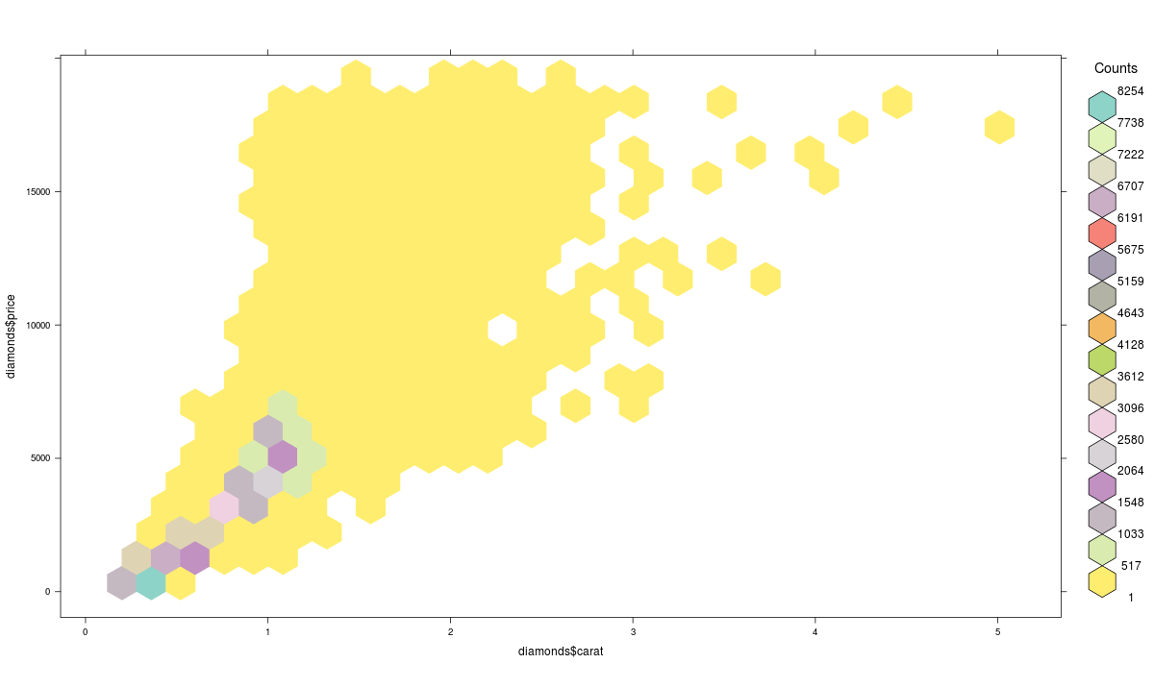
Hexagonal Binning
A form of bivariate histogram useful for visualizing the structure in datasets with large N.
The xy plane over the set (range(x), range(y)) is tessellated by a regular grid of hexagons;
The number of points falling in each hexagon are counted and stored in a data structure;
The hexagons with count > 0 are plotted using a color ramp or varying the radius of the hexagon in proportion to the counts.
Source: https://cran.r-project.org/web/packages/hexbin/vignettes/hexagon_binning.pdf

Slide 90
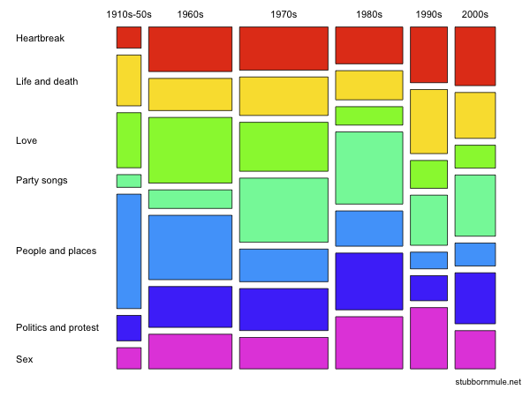
Mosaic Plot
Mosaic plot is a graphical method for visualizing data from two or more qualitative variables
Mosaic plot showing cross-sectional distribution through time of different musical themes in the Guardian's list of "1000 songs to hear before you die".
Source: https://en.wikipedia.org/wiki/Mosaic_plot

Slide 91
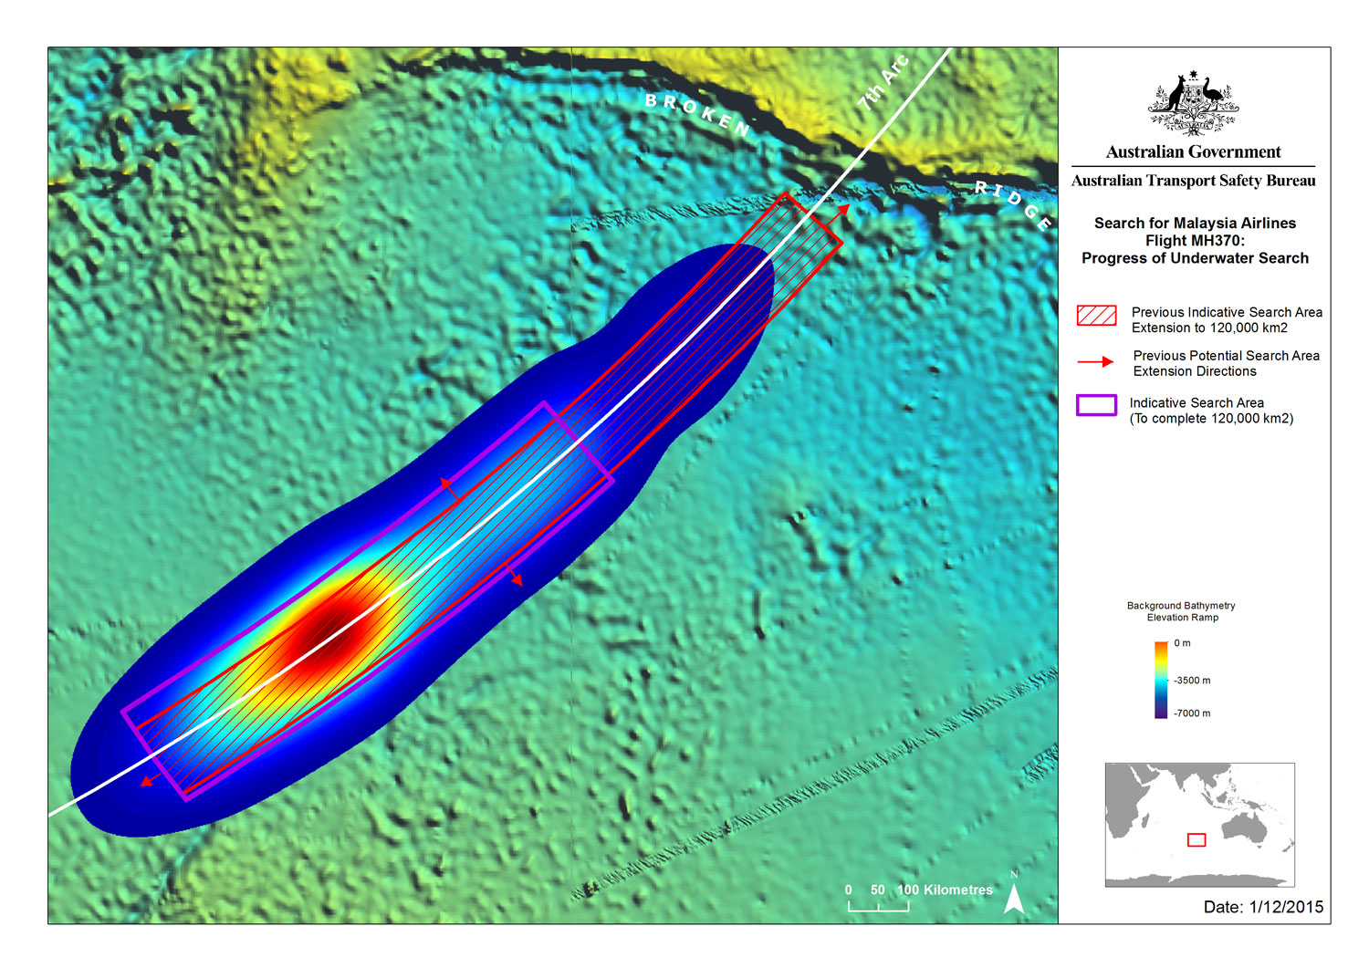
Heat Map: Using Color to Represent a 3rd Dimension
The probable location of missing Malaysia Airlines Flight 370

Slide 92
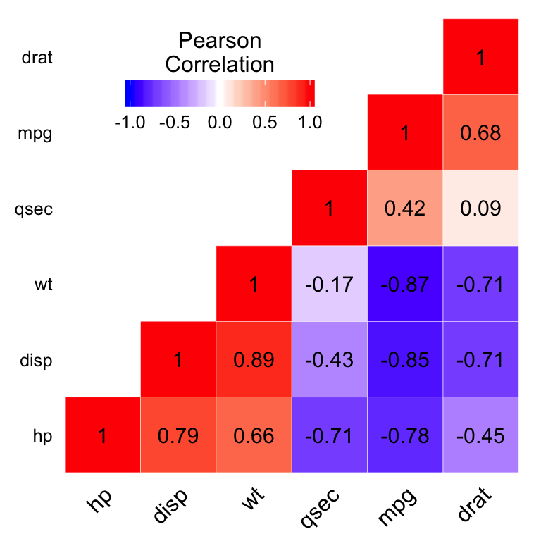
Heat Map: Using Color to Represent a 3rd Dimension
A Correlation Heat Map

Slide 93
Q & A

